Slide 1

Hotel Rating Classification
TEAM MEMBERS: Group :- 2
Mr.Tushar Padavi
Mr.Suraj Tirgul
Mr.Dhiraj Hajare
Ms.Pooja Pawar
Mr.Saurabh Sigh
Mr.Alexander Kumarsamy
Ms.Nehal Mistry

Slide 2
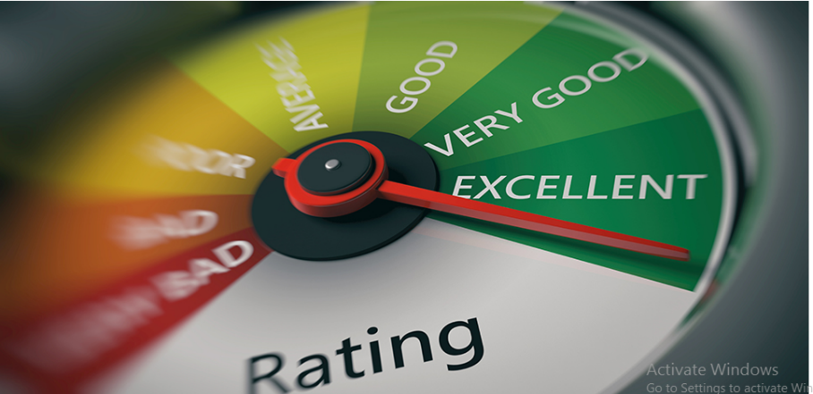
Hotel Rating Classification
Whenever We Are Looking For Hotels For Vacation Or Travel, We Always Prefer A Hotel Known For Its Services. The Best Way To Find Out Whether A Hotel Is Right For You Or Not Is To Find Out What People Are Saying About The Hotel Who Have Stayed There Before. Now It Is Very Difficult To Read The Experience Of Each Person Who Has Given Their Opinion On The Services Of The Hotel. This Is Where The Task Of Sentiment Analysis Comes In. Well, Every Industry Is Now Adopting Sentiment Analysis To Assess Its Reputation In The Online Market. The Hospitality Industry Is Following The Same Path With Hotel Reviews Sentiment Analysis.

Slide 3

Problem Statement
In this project, our goal is what are the attribute that travellers are considering while selecting a hotel. With this manager can understand which element of there hotel influence more in forming a positive review and improve hotel brand image.

Slide 4
Work Flow
So we will divide our work flow into following 3 steps.
Data Collection
and
understanding
Data Cleaning
and
Manipulation
Exploratory
Data
Analysis(EDA)

Slide 5
Data Collection And Understanding
After collecting data its very important to understand your data. So we has hotel Rating classification data. Which has 20491 rows and 2 columns . So lets understand this 2 columns.
Data Description:
Review: A customer review is reflection of a customer’s experience with hotel’s services
Rating: Rating and reviews allow customers to share their experience with a product or services, and give it an overall star rating or as a number 0 to 5

Slide 6
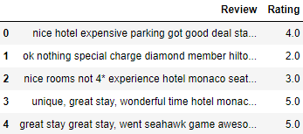
Hotel Rating and Review Dataset This is a Hotel Reviews Dataset . In the below table its show the top 5 rows respectively:

Slide 7
EDA
Part

Slide 8
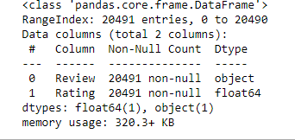
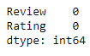
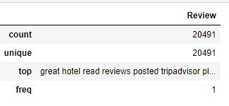
Text The Data Understanding And Checking Missing/Null Values
Data Info
Checking the size of dataset
Checking the null values in dataset
Checking the Duplicate Values
Statistical description of data (reviews)

Slide 9
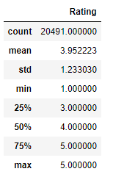
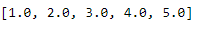
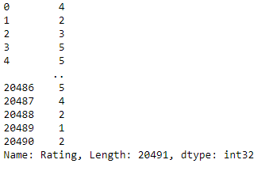
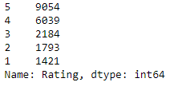
Statistical description of data (ratings)
Unique rating values
Converting the ratings column from float to int
Count of ratings after change in data-type
From above analysis, we can say that there are no null values & duplicate data in our dataset.

Slide 10
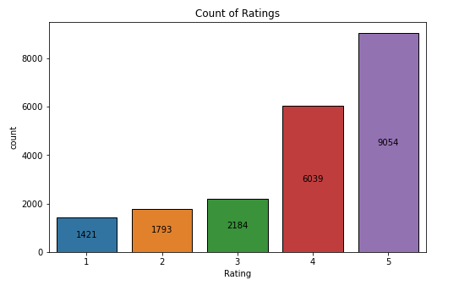
Count Plot of Rating
From above visual, we can say that count of ratings for 4, 5 are comparatively much higher than the other rating scores.
Hence, we can say for our data that most of the users are highly satisfied with their experience at hotels.

Slide 11
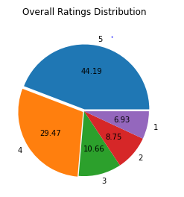
Checking the total contribution of all ratings
From above visual , we can say that almost 75% of reviews are rated(5,4) by users and remaining 25% review's are
Rated(3,2,1).
We have an unequal distribution of data, where we have less no. of negative rating provided by users.
hence, our dataset is highly imbalanced dataset.

Slide 12
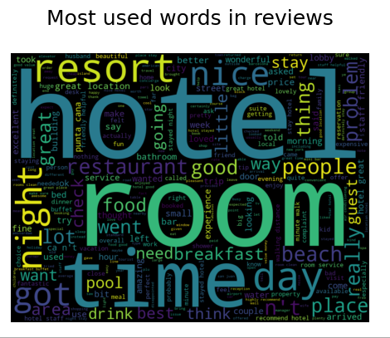
Checking the most used words from reviews & plotting it using Word Cloud
Plotting the word cloud on original data for all ratings
Hotel, room, time, resort, beach, day, night, & people etc. were most commonly used words in overall reviews by users.

Slide 13
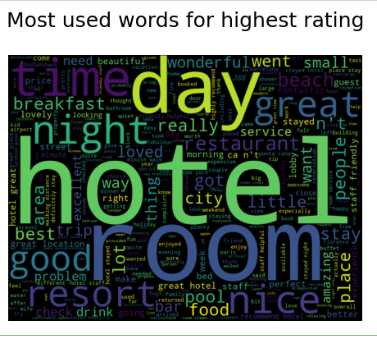
Plotting the word cloud on original data for all highest rating (5)
Great, nice, wonderful, good, loved, restaurant, hotel, room, day, etc. were some frequently used words by users who rated for score of 5, it seems they had a delightful experience at hotel.

Slide 14
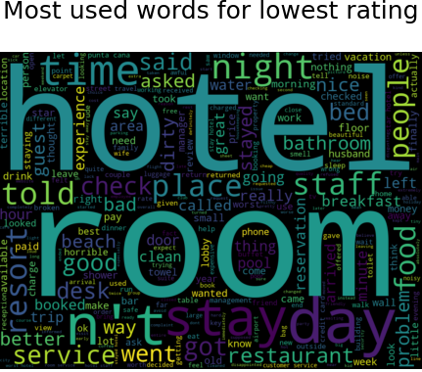
Plotting the word cloud on original data for all lowest rating (1)
The users who were not happy or rated low for their experience have used Service, problem, staff, desk, better, told, dirty, bad, day, hotel, room, food etc. these words frequently in their reviews.

Slide 15
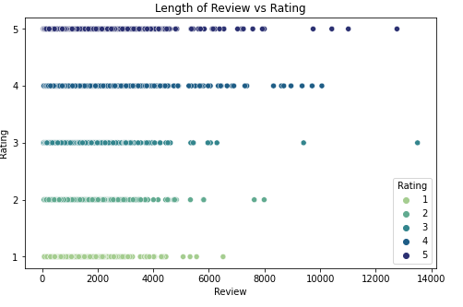
Checking the length of words in a review for all the rating
From above visual, we can say that the length of review has an effect on ratings.
Lower ratings have lower length of review compared to top ratings.
Hence, there exists a positive correlation between Length of Reviews & Ratings.

Slide 16
Text Data Pre-Processing & Cleaning In Text Data Pre-processing and Cleaning we did this following Steps:-
1) Make a copy of original data
2) Remove all punctuations, numeric, symbols and other unnecessary white space and characters from data
3) Remove the Stopwords
4) Tokenisation of each words
5) Apply Lemmatization to the data

Slide 17
Sentiment Analysis
Rule Based
VADER (Valence Aware Dictionary for Sentiment Reasoning)
TextBlob
Lexicons with polarity scores – Afinn
Model Based
Logistic Regression
Naive Bayes
Distilbert - Pretrained hugging face model

Slide 18
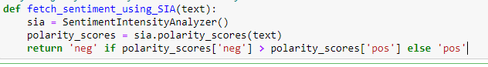
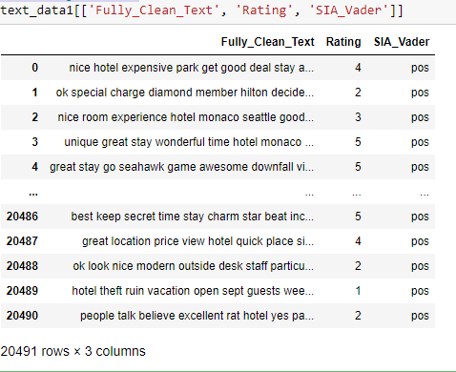
Using NLTK's VADER - Sentiment Intensity Analyse
Defining a function for Sentiment Analysis
Applying the VADER function to entire data
Reviewing the data
Vader is a lexicon and rule based sentiment analysis tool specifically calibrated to sentiments most commonly
expressed on social media platforms. When calculating a polarity score.
Vader outputs four metrics:
Compound, Negative, Neutral and Positive.
The compound score calculates the sum
of all lexicon ratings which is normalized
between -1 (most negative) and +1 (most positive).

Slide 19
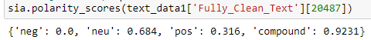
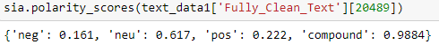
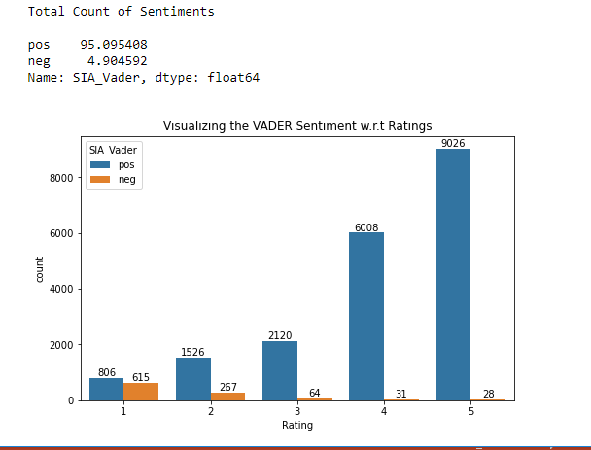
Testing The Positive Sample
Visualizing the Vader Sentiment Analysis
Testing The Negative Sample
After testing two random samples,
negative sample review is incorrectly
tagged as positive.
As we can see, from above sentiment analysis visual
almost 95% reviews are tagged as "Positive"
using NLTK's VADER approach

Slide 20
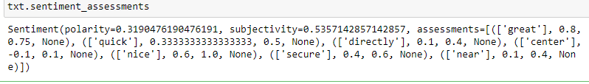
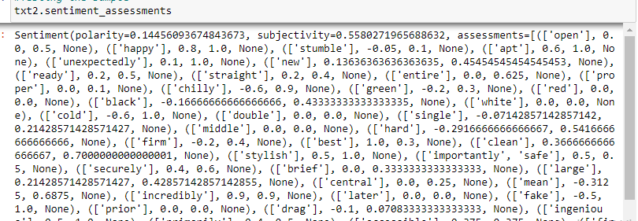
TextBlob
Testing the positive sample
TextBlob is built on top of NLTK and
also it is very easy to use and can
process the text in a few lines of code.
TextBlob can be used for complex analysis
and working with textual data.
When a sentence is passed into TextBlob
it gives two outputs, which are polarity and subjectivity.
Polarity is the output that lies between [-1,1],
where -1 refers to negative sentiment
and +1 refers to positive sentiment.
Subjectivity is the output that lies within [0,1]
and refers to personal opinions and judgments.
Testing the negative sample

Slide 21
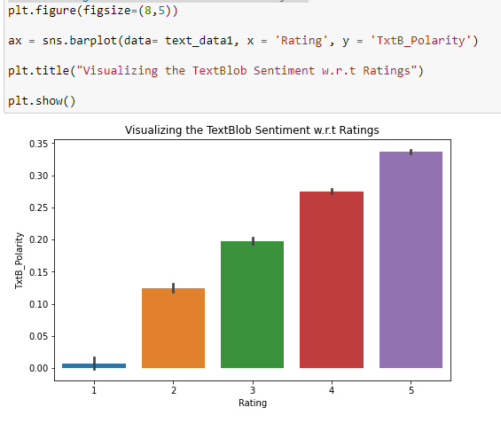
Visualizing The TextBlob Sentiment Analysis
Negative reviews polarity scores is not negative but positively low scored. Hence, it is difficult to interpret the positive & negative reviews.
After testing two random samples, negative sample review is incorrectly tagged as positive using Text Blob.

Slide 22
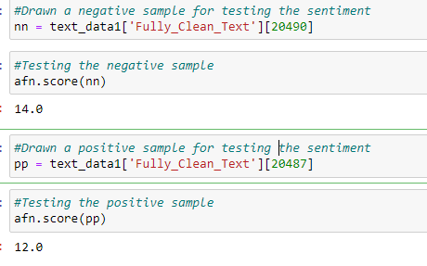
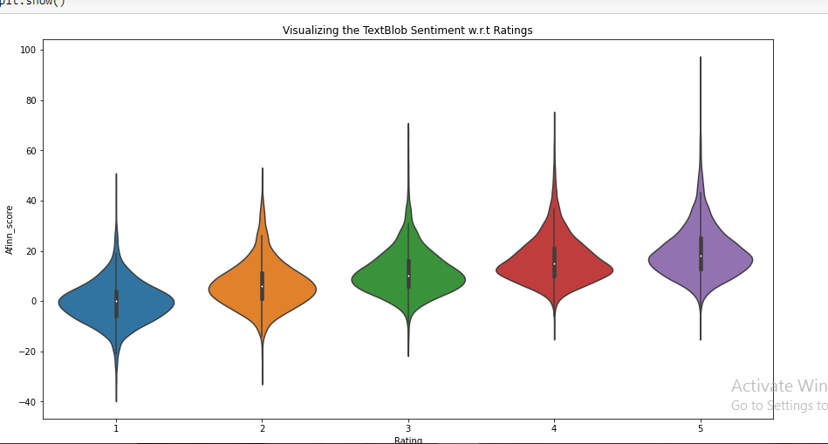
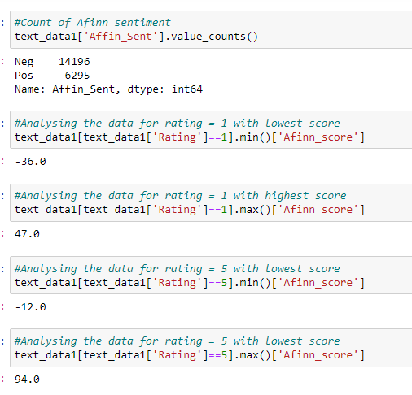
Afinn Sentiment Analysis
Afinn is the simplest yet popular lexicons used for sentiment analysis developed by Finn Årup Nielsen. It contains 3300+words with a polarity score associated with each word.
Afinn is a list of words rated for valence with an integer between minus five (negative) and plus five (positive). The comparative score is simply: sum of each token / number of tokens.
As we can see from above, top rated reviews min Afinn score is negative, bottom review highest afinn score is positive.
Hence, afinn is better than previously rule based sentiment analysis, but unable to segregate between lowest and highest review.

Slide 23
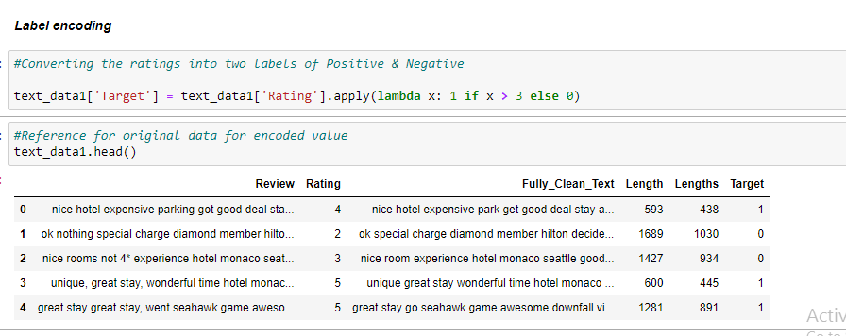
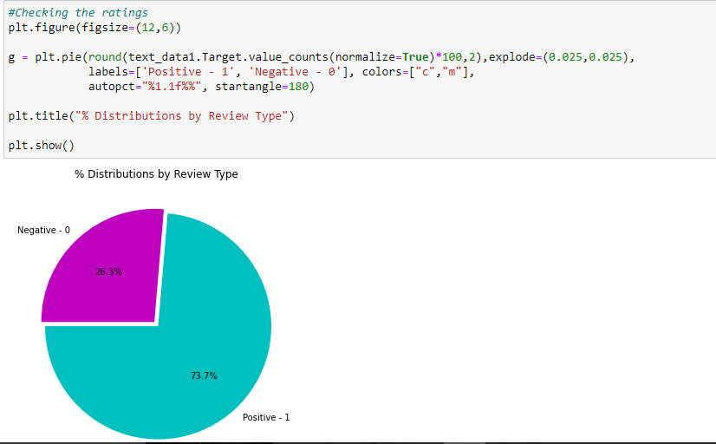
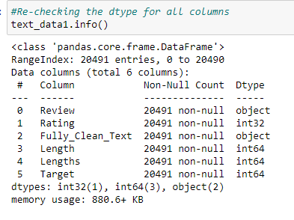
Model Based - Machine Learning
Naive Bayes & Logistic Regression based Sentiment Analysis
From above visual, we can say that most of the reviews are positive and only around 26% are negative reviews

Slide 24
Model Building

Slide 25
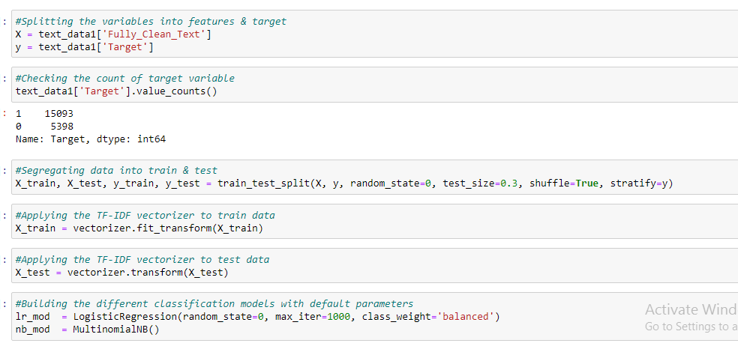
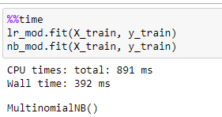
Model Building
Building Models with default parameters & imbalanced data
Model Training with above base models

Slide 26
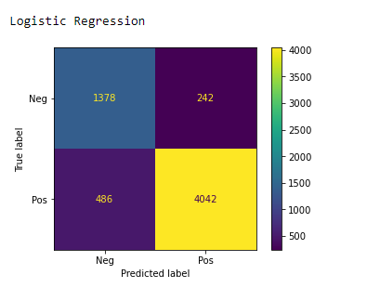
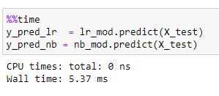
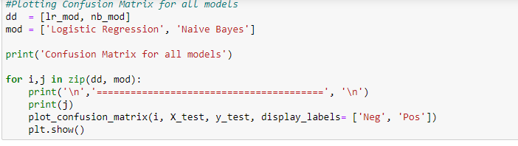
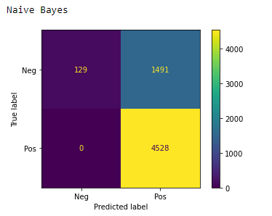
Model Testing & Evaluation
From above model evaluation :

Slide 27
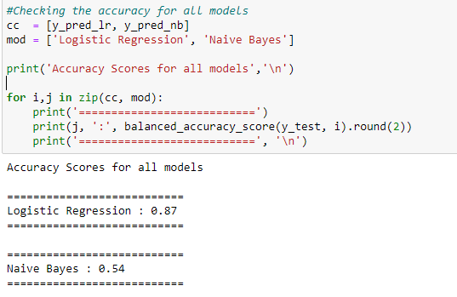
Analysing The Model Performance & Accuracy
As per confusion matrix, our goal is minimise the False Positives & Negatives. Hence, Logistic Regression model was able to minimise False Negatives & Positives but still we have to reduce it as much possible.

Slide 28
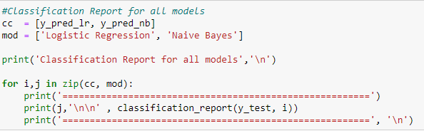
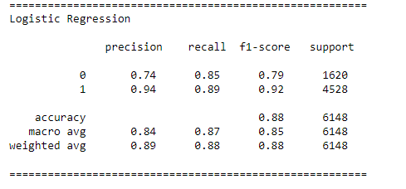
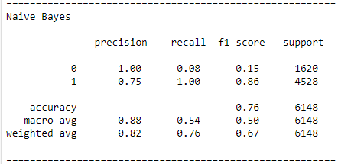
Classification Report of All Model
As per classification report, we would try to maximise recall class 0, 1. Naive Bayes model’s recall value for class 0 is poor
compared to Logistic Regression model.

Slide 29
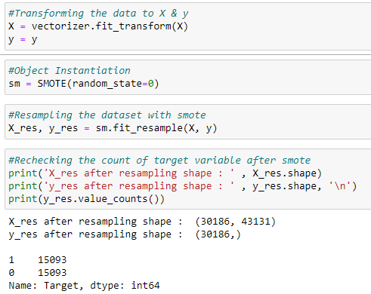
Applying Sampling Techniques for Imbalancing Dataset
Sampling Techniques
1)SMOTE
2)ADASYN
3)Random Under Sampler
4)Tomek Links
1) SMOTE: Synthetic Minority Over-sampling Technique
SMOTE works by selecting pair of minority class observations and then creating a synthetic point that lies on the line connecting these two. It is pretty liberal about selecting the minority points and may end up picking up minority points that are outliers.

Slide 30
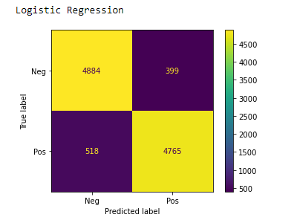
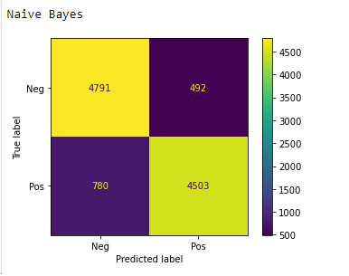
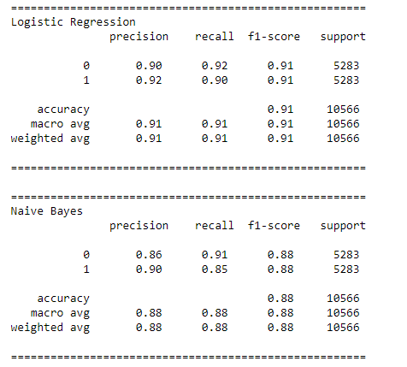
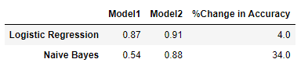
Confusion matrix for all models
Classification report of all models
ata with balanced accuracy score
Comparing the models imbalance & Model Smote_Balanced
From above analysis, we can say that after applying the sampling method - smote technique to our data, the accuracy has improved by more than 30% for Naive Bayes model. also, the recall class 0, 1 has been been improved. but, smote has simply oversampled minority class ("Negatives - 0" in our case).

Slide 31
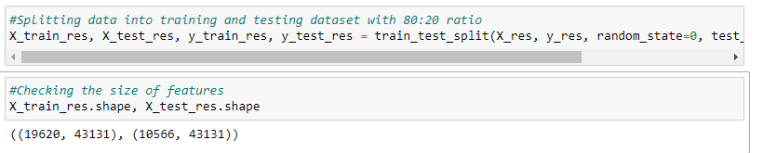
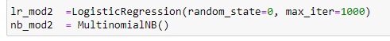
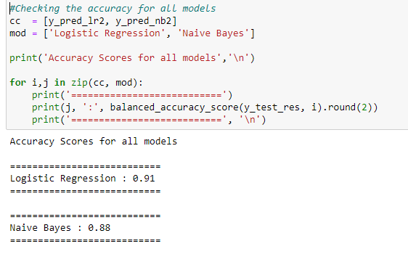
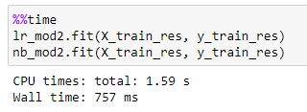
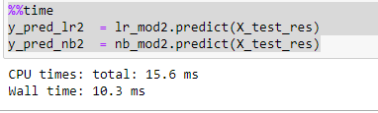
Building Models With Balanced Data (Smote Resampled Data)
Model Building With Default Parameters &
Smote_re-sampled Data
Model Training
Model Testing & Evaluation

Slide 32
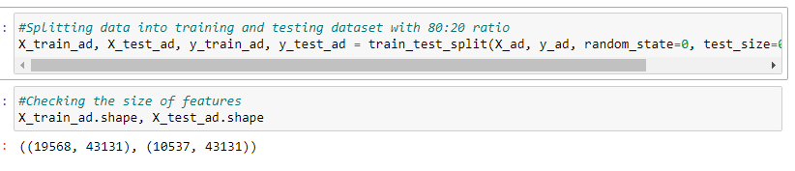




Adaptive Synthetic Sampling (ADASYN)
Building models with balanced data (ADASYN)
It involves generating synthetic samples inversely proportional to the density of the examples in the minority class. That is, generate more synthetic examples in regions of the feature space where the density of minority examples is low, and fewer or none where the density is high.

Slide 33





Testing the ROC-AUC score for all models
Plotting Confusion Matrix for all models
Classification Report for all Models
Comparing the models imbalance & model random-under-Sample Balance data with balanced accuracy score
From above analysis ,there's a minimal improvement in minority class compared to smote technique, even though the accuracy remained the same more or less.

Slide 34





Random Under Sampler :-
A simple under-sampling technique is to under-sample the majority class randomly and uniformly. this can potentially lead to the loss of information. but if the examples of the majority class are near to others, this method might yield good results.

Slide 35





Testing the balanced accuracy for all Models
Plotting Confusion Matrix for all models
Classification Report for all models
Comparing the models imbalance & model random-under-sampler _ balance data with balanced accuracy score
The majority class data has been brought down close to minority class.
There's a decrement in the accuracy for Logistic Regression as well as the Naive Bayes accuracy scores compared to smote data accuracy score.
Let's try with the another down sampling technique.

Slide 36





Tomek Links
Tomek Links ability to remove the data that are identified as Tomek links from the majority class (that is, samples of data from the majority class that is closest with the minority class data)
Testing the accuracy score for all models

Slide 37




Plotting Confusion Matrix for all models
Classification Report for all Models
Comparing the models imbalance & model Smote_Balance data with balanced accuracy score
From above analysis, We can see there's a decrement in minority recall class 0, for Logistic Regression & Naive Bayes model compared to other sampling techniques. both, these models have under performed with this technique.

Slide 38


After analysis of sampling techniques, we will choose smote resampled data for further analysis for machine learning based sentiment analysis. hence, as we observed the accuracy, precision and recall score have been improved using smote
ML Model Stability & Performance
Cross Validation on original data
Cross Validation on smote data
The cross validation score is around 89% for Logistic Regression with 1% deviation, 77% for Naive Bayes model with 1.2% deviation on original dataset respectively.
The cross validation score is around 92% for Logistic Regression with 0.7 % deviation, 88% for Naive Bayes model with around 0.6 % deviation on smote resampled dataset respectively.

Slide 39


Building Model Using Deep Learning
Model Based - Deep Learning pretrained models
DistilBert - Sentiment Analysis
Model Description: This model is a fine-tune checkpoint of DistilBert-base-uncased, fine-tuned on SST-2. This model reaches an accuracy of 91.3 on the dev set (for comparison, Bert-base-uncased version reaches an accuracy of 92.7).
Model is able to predict even the sarcastic sentences and provides score of the sentiment which is great!!
Model is working perfectly fine and hence, can be used for deployment.

Slide 40



.
Building Pipeline
Making pipeline for the ML classification based models to automate the process of pre-processing, training & predicting the data.

Slide 41


Testing The Pipeline On Our Dataset

Slide 42


Reviewing the data after dropping the test samples

Slide 43



Training Model
Training the model using Logistic Regression
Splitting the original data for training the model

Slide 44


Training the model using Naive Bayes

Slide 45
Conclusion
After comparing the performance & accuracy for 2 classification models, both performed well. Since, the accuracy of Logistic Regression has higher precision & recall score we can finalise this model for our dataset.
We can also finalise the pre-trained model, as it was able to correctly judge the statement and also provide a sentiment score thereon.
Hence, we can go ahead and finalise our model 2, since dataset is not complex and overall stability and performance of model is good.

Slide 46
Deployment

Slide 47

Streamlit

Slide 48

Positive Statement
This Statement and review users are highly satisfied with their experience at hotels.

Slide 49

Negative Statement
This Statement and review users are highly unsatisfied with their experience at hotels.

Slide 50
Thank you…!

